Slide 1
M2 Exam
Ali Moghadas
Emina Gracanin
Amalie Hougaard Lang

Slide 2
Problem and Dataset
Goal
To identify, categorize, and analyze risk-related information from corporate earnings transcripts using a Large Language Model (LLM) and construct a knowledge graph (KG) representing the network of risks across companies.
Dataset
Source: kurry/sp500_earnings_transcripts (Hugging Face)
Content: S&P 500 companies’ quarterly earnings call transcripts.
Fields: symbol, company_name, quarter, year, date, content, etc.
Subset: Randomly selected 20 transcripts for experimentation and scalability testing.
Rationale: A manageable sample for LLM inference cost and runtime, while maintaining diversity across sectors.

Slide 3
Pipeline Overview
Step 1: LLM-Based Risk Sentence Filtering
Goal: Token Budget Controlling.
Tool: spaCy for sentence segmentation.
Logic: Sentences containing risk-related keywords (e.g., “uncertainty”, “safety”, “liability”, “pollution”) were retained.
Output: A condensed transcript (filtered_text) focusing only on risk discussions.
Step 2: Risk Extraction via LLM
Model: gemini-2.5-flash (through the Gemini API).
Prompt: Instructed the LLM to extract structured JSON objects of the form:
· {
· "company": "AAPL",
· "risk_type": "operational",
· "sentence": "We faced supply chain disruptions due to the pandemic."
· }
Safety: Implemented retry logic, exponential backoff, and JSON cleaning to ensure reliable responses.
Output: Structured risk records across companies.

Slide 4
Pipeline Overview 2
Step 3: Knowledge Graph Construction
Nodes: Companies and risk types.
Edges: Relationships formed when a company mentions a specific risk.
Visualization: NetworkX or PyVis used to render the company–risk network, showing which firms share exposure to similar risks.
Step 4: Analysis
Frequency Analysis: Count of risk mentions per category and company.
Centrality Measures: Identified companies central to certain risk clusters.
Insights: Visualized patterns of common risk exposure across the S&P 500 subset.

Slide 5
Main Results
Key Findings
Common risk themes across sectors included market volatility, supply chain disruption, and regulatory compliance.
Financial and technology companies showed strong overlaps in cybersecurity and data protection risks.
Environmental risks were less frequent but concentrated in energy and materials firms.
Several generic “forward-looking statement” disclaimers appeared as recurrent phrases — highlighting a need for semantic filtering beyond keyword matching.

Slide 6
Visualization
Visual Highlights
Cluster: Cluster of embedded data with semantic similarity
Bar Chart: Frequency of top 10 risk types across the dataset.
Network Graph: Nodes sized by number of unique risk connections (company–risk edges).
Word Cloud: Dominant risk terms in the filtered corpus.

Slide 7
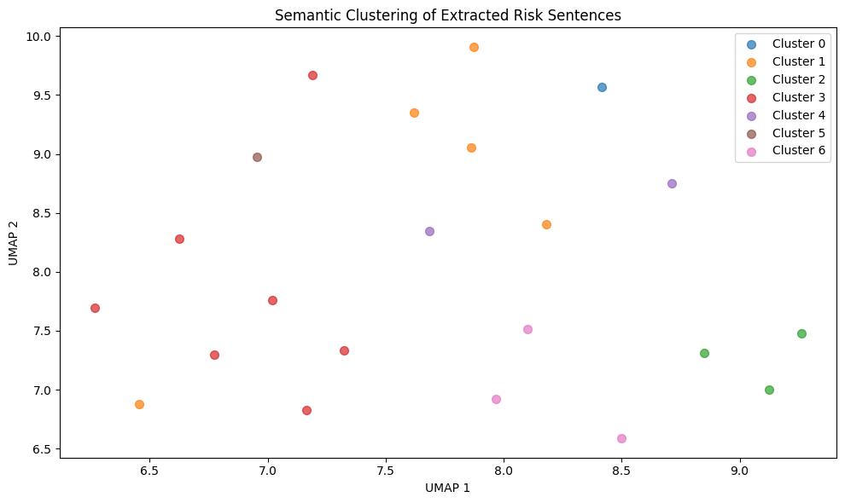

Slide 8
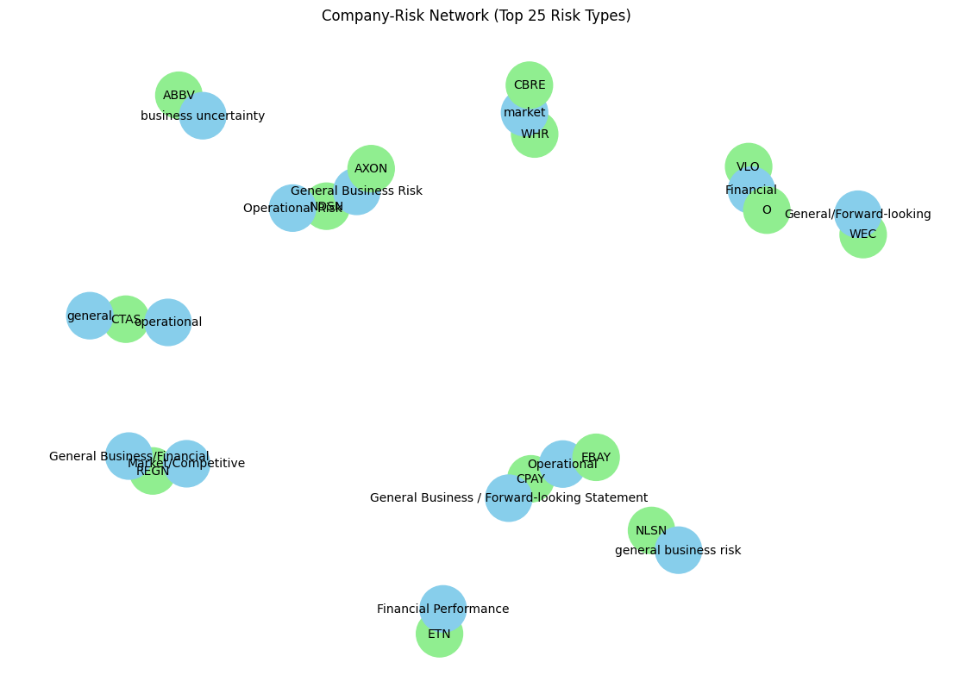
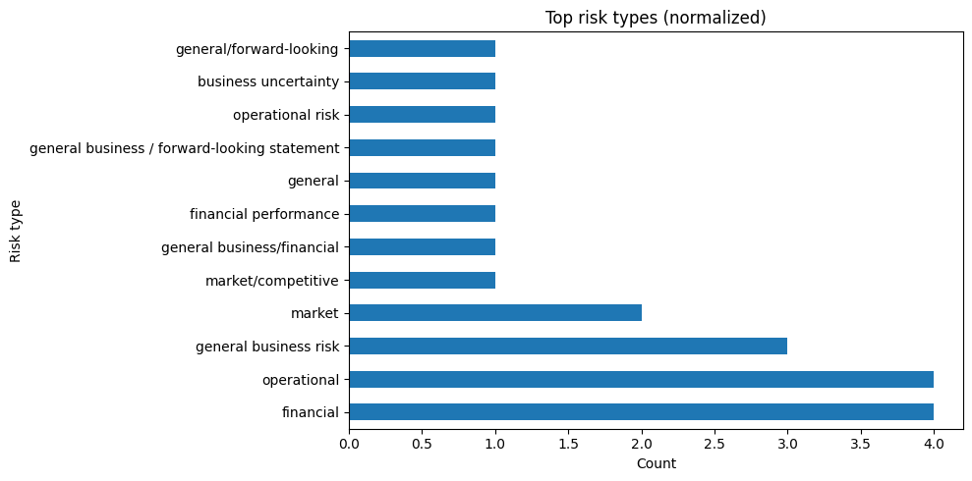

Slide 9
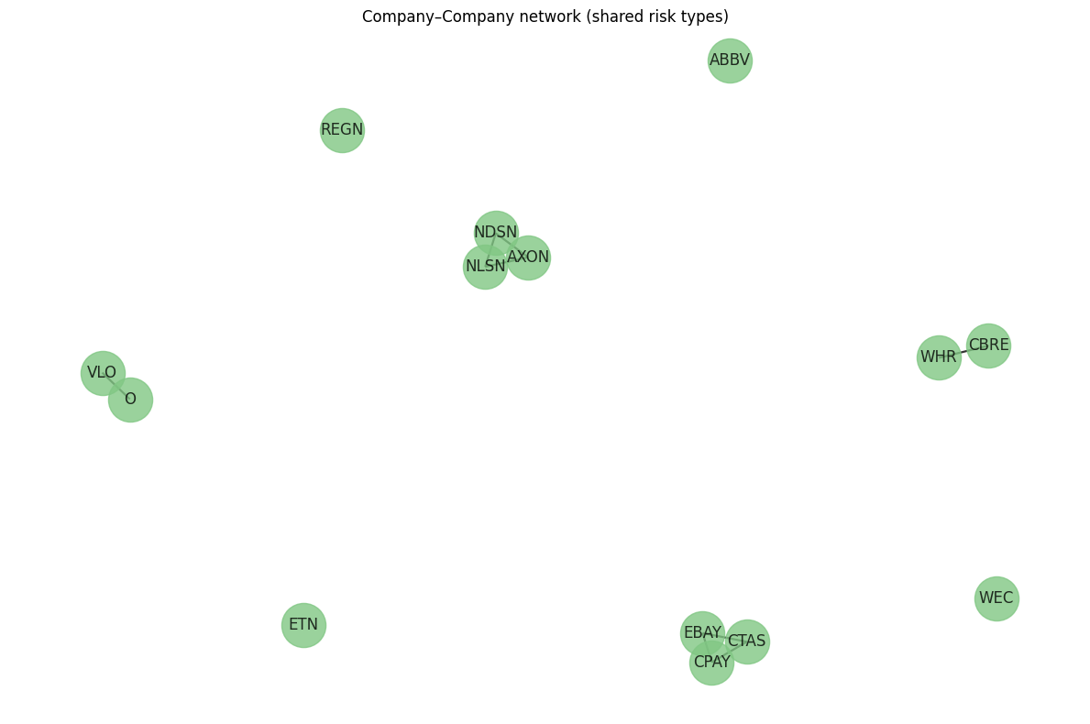
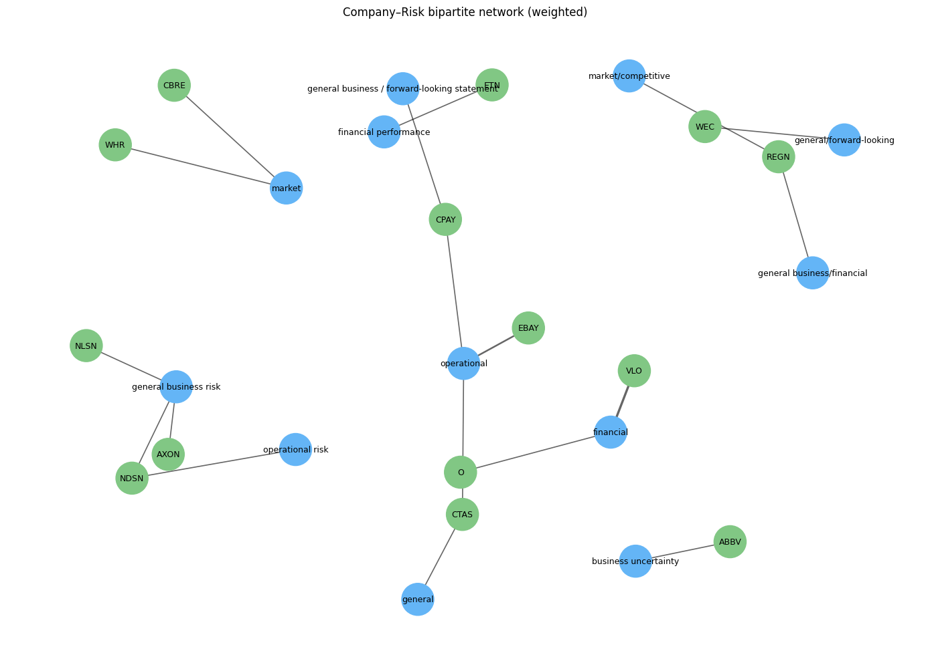

Slide 10
Conclusion and Open Questions
Conclusions
The pipeline successfully extracted structured, interpretable risk information from unstructured text.
Combining rule-based keyword filtering with LLM-based extraction proved efficient and cost-effective.
The resulting knowledge graph enables visual and quantitative insights into cross-company risk exposure.
Limitations
The initial keyword filter may omit implicit risks (e.g., “economic slowdown” without the word “risk”).
Some repeated or generic legal disclaimers inflated certain categories.
LLM outputs depend on prompt design and token context limits.
Open Questions / Future Work
How can we improve semantic coverage — e.g., using contextual embeddings instead of keyword filters?
Can we integrate financial data (e.g., stock performance) to correlate risk mentions with market behavior?
Could temporal analysis reveal trends in emerging risks across quarters?

